Slide 1
Innovative GIS Analysis with Geogpt
Harnessing AI for Advanced Geospatial Operations
Presented by:
Date:
Event:

Slide 2
Introduction to GeoGPT
GEOGPT OVERVIEW
Integrates advanced large language model capabilities tailored for geospatial analysis
Simplifies GIS operations with natural language processing capabilities
ENHANCING GEOSPATIAL ANALYSIS
Transforms complex GIS queries and commands into simple conversational interactions
Automates data collection, analysis, and visualization to accelerate decision-making
BROADENING GIS ACCESSIBILITY
Makes geospatial analysis accessible to a broader audience, including non-experts
Encourages adoption across various fields like urban planning, environmental monitoring, and resource management
EFFICIENT WORKFLOW IMPLEMENTATION
From spatial queries to actionable outputs: GeoGPT streamlines the creation of maps, charts, shapefiles and reports
Reduces manual data manipulation, enhancing productivity and insight discovery

Slide 3
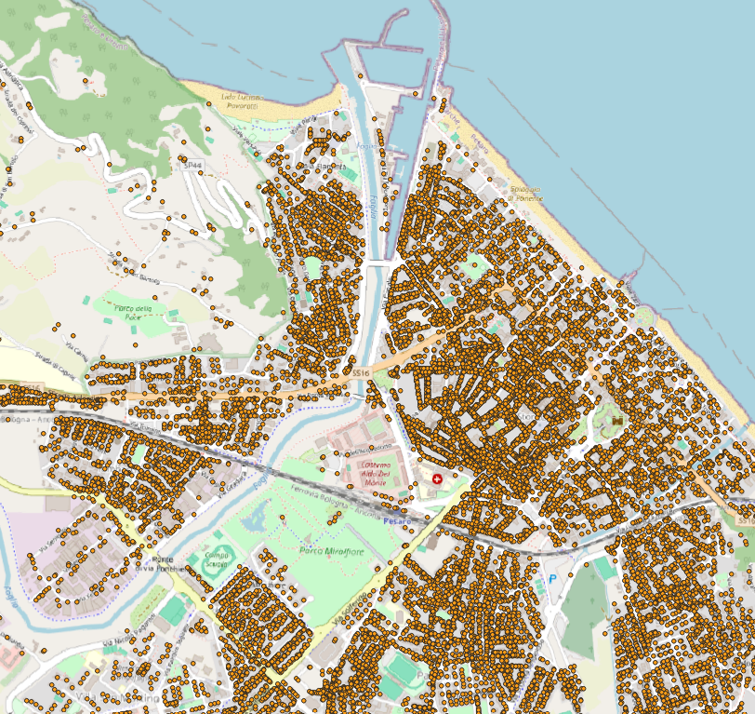
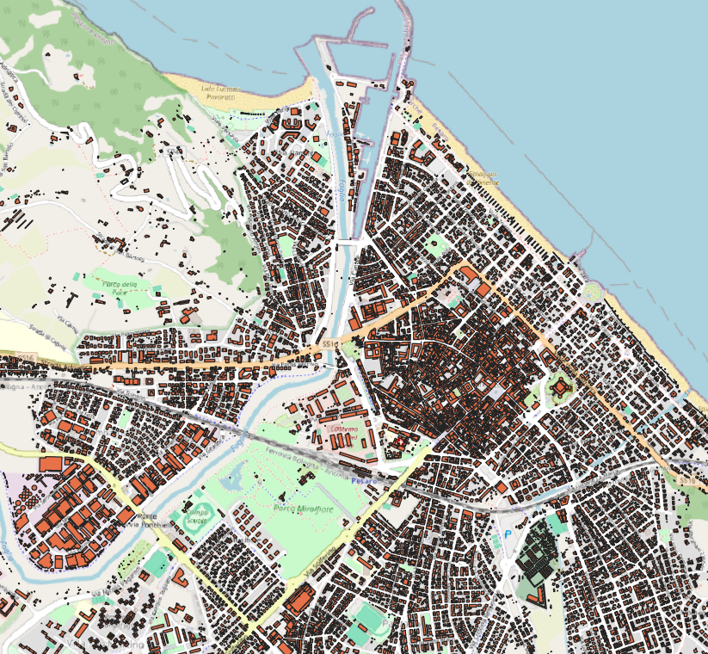
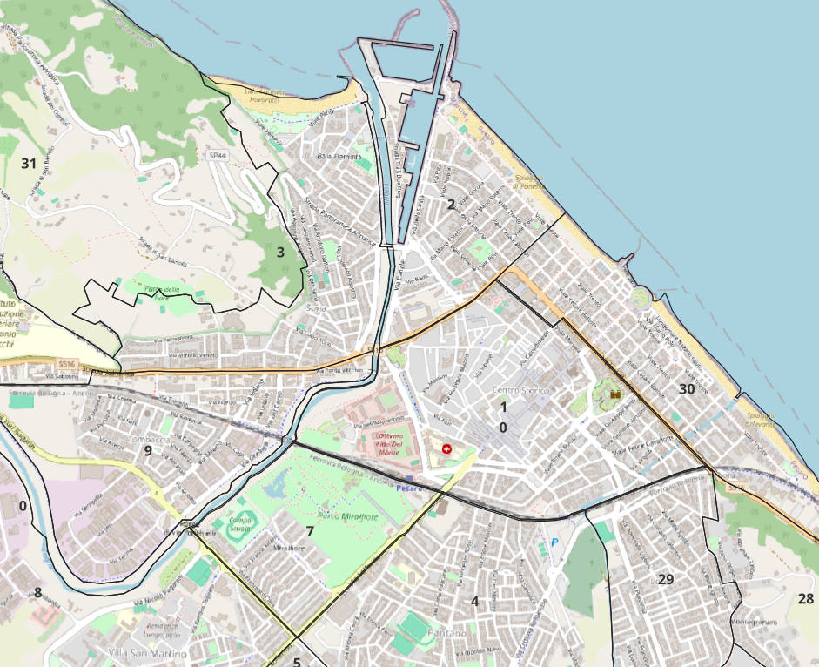
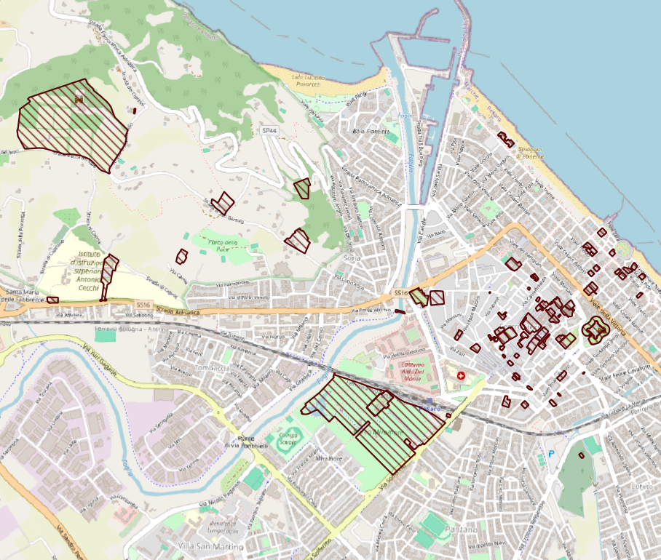
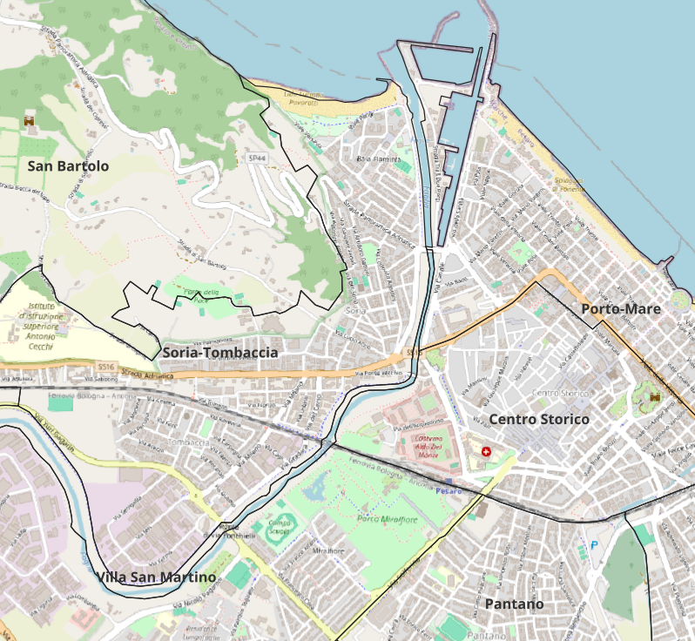
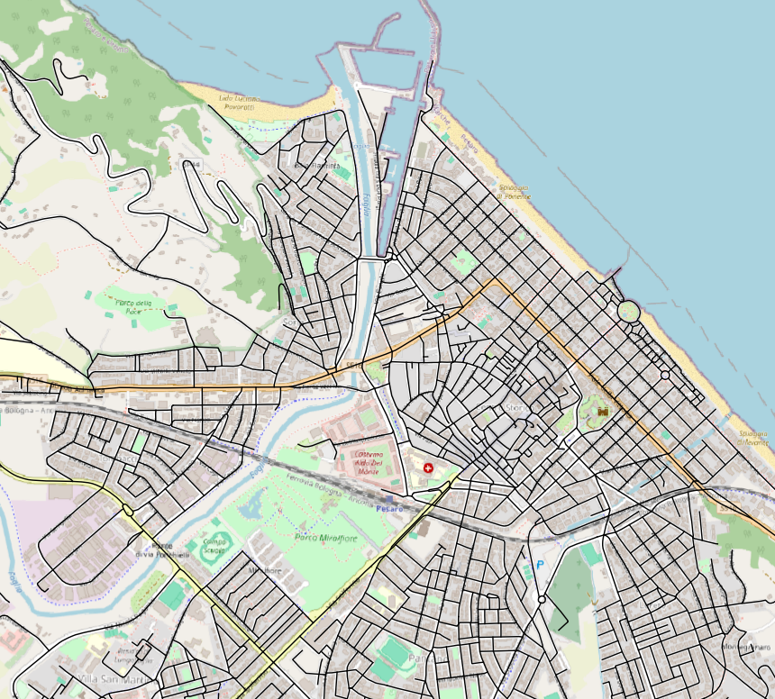
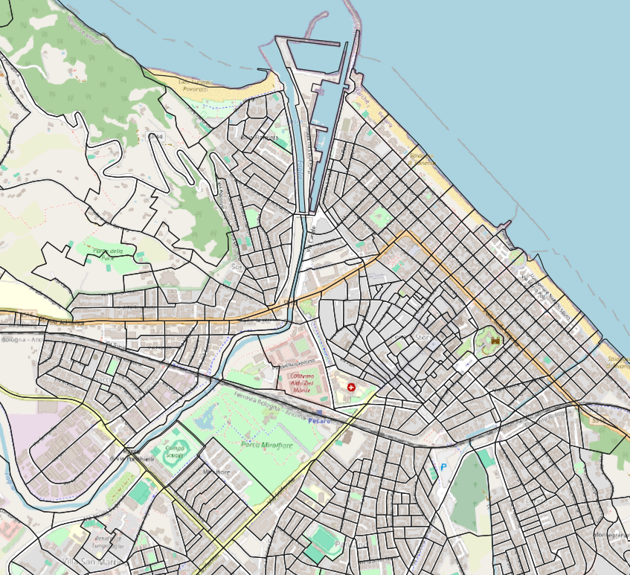
Data Integration in Pesaro’s GIS Analysis (CSV/SHAPEFILES)
Addresses: Foundation for navigation and urban planning with precise geolocations
Buildings: Details building heights and construction years, critical for urban morphology studies
Districts: Demographic and boundary data supporting policy and resource allocation
Monumental Bonds: Highlights protected areas, key to cultural heritage and tourism
Neighborhoods: Provides insights into socio-economic patterns for community-focused initiatives
RoadMap: Outlines transportation networks, vital for infrastructure planning
ISTAT Sections: Offers detailed census data for comprehensive statistical analysis

Slide 4
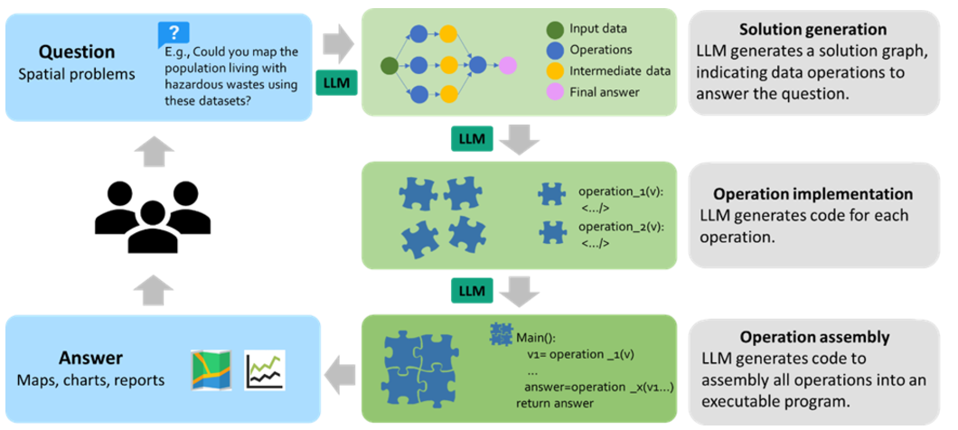
EXECUTION PROCESS
The LLM-GPT-4 model, utilizing the GeoGPT framework, generated a script to process and integrate both the CSV and shapefile data. Key steps included:
1. Loading and Cleaning Data: Both the CSV and shapefile data were loaded, with a cleaning process to eliminate records with missing values, ensuring high-quality spatial analysis.
2. Data Integration: The datasets were joined based on common attributes, such as building height (height in CSV and altezza in the shapefile) and year of construction (year_ctr in CSV and annoctr in the shapefile).
3. Geospatial Processing: The script adjusted map projections to ensure that both datasets aligned spatially for accurate geographic representation.
4. Visualization Execution: Utilizing matplotlib and geopandas, two maps were created:
A map color-coded by building heights to visualize vertical development across Pesaro.
A chronological map of buildings highlighting different construction epochs.
Process from query to solution, highlighting the automated generation and execution of geospatial operations

Slide 5
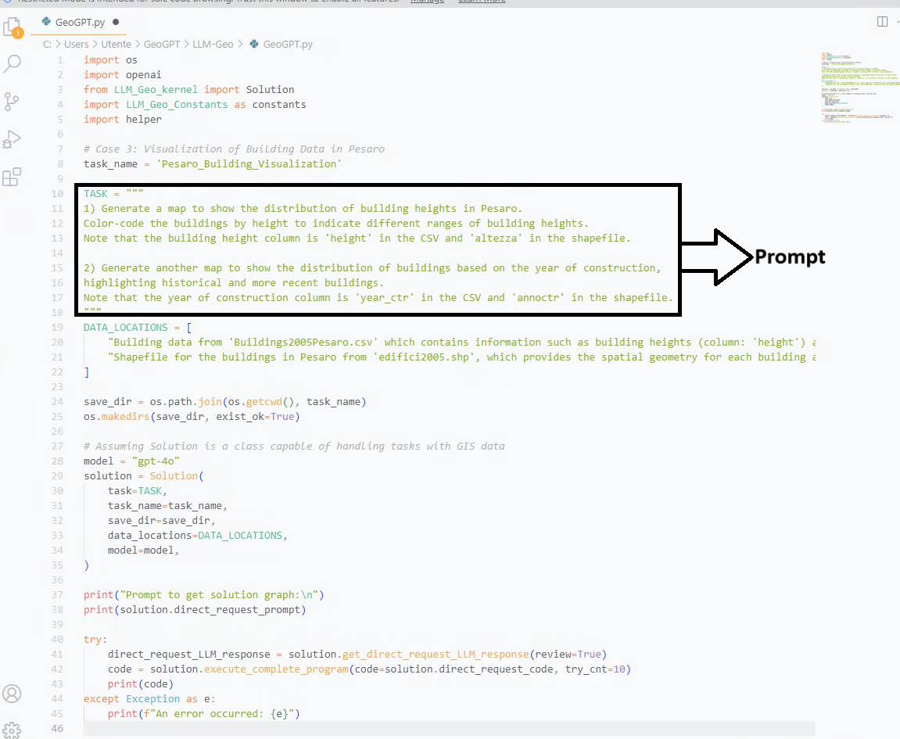
PROMPTS USED
Execution Process:
1-Code Overview:
Introduces GeoGPT’s Python-based script for processing and visualizing building data in Pesaro using both CSV and shapefile formats.
2-Data Integration and Processing:
Utilizes Python libraries such as pandas for data manipulation and geopandas for spatial operations.
Aligns and merges building attributes from CSV (Buildings2005Pesaro.csv) with spatial geometries from shapefiles (edifici2005.shp).
3-Automated Visualization:
Generates two maps/shapefiles :
A map color-coded by building heights (height).
A chronological map displaying the year of construction (year_ctr).
4-Script Execution:
Details the interactive execution within a python vscode environment, illustrating GeoGPT’s capability to automate the generation of actionable GIS outputs.
Displays how the script interacts with the GeoGPT framework to automate tasks, making complex GIS data analysis more accessible.

Slide 6
Enhancing GIS with GeoGPT: Capabilities and Innovations
Intelligent Debugging:
Features advanced error detection and correction capabilities, providing real-time debugging assistance during data analysis to ensure the accuracy and reliability of GIS outputs.
Automated Code Generation:
GeoGPT streamlines GIS workflows by automatically generating Python scripts tailored to specific geospatial tasks based on natural language inputs, enhancing productivity and reducing manual coding efforts.
Advanced Data Handling:
Supports intricate spatial data manipulations such as projections, transformations, and spatial joins directly through user-friendly commands, making complex operations more accessible to non-experts.

Slide 7
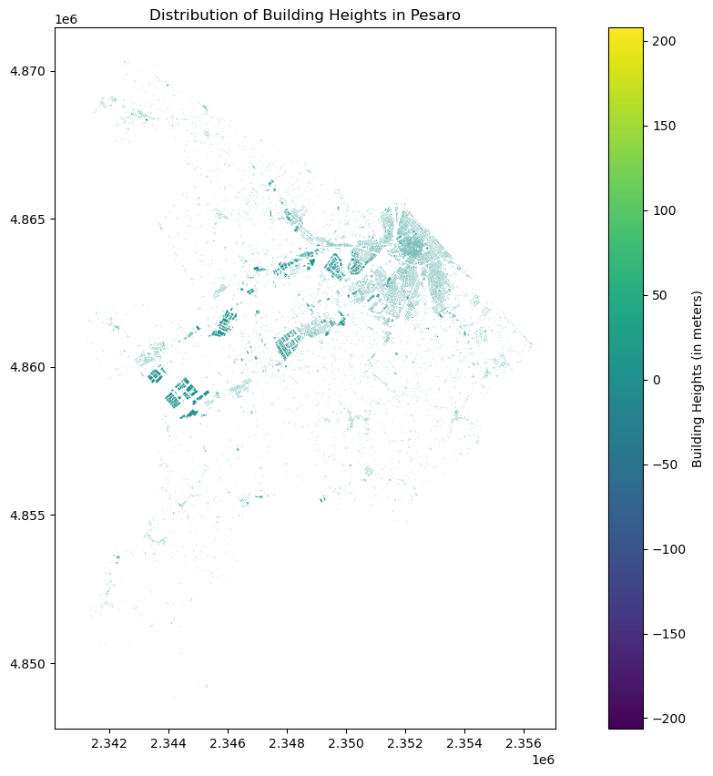
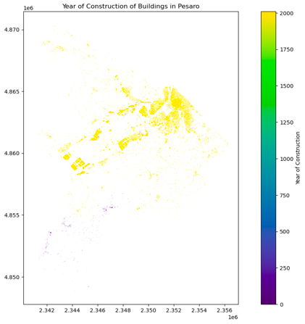
Results : generated Maps WITH LLM
Building Height Map: This map displays the distribution of building heights, using a gradient color scheme to easily identify areas with taller structures versus lower ones. It is instrumental in urban planning and zoning.
Year of Construction Map: Reveals the temporal distribution of building activities over decades, which is crucial for historical analysis and future urban planning initiatives.

Slide 8
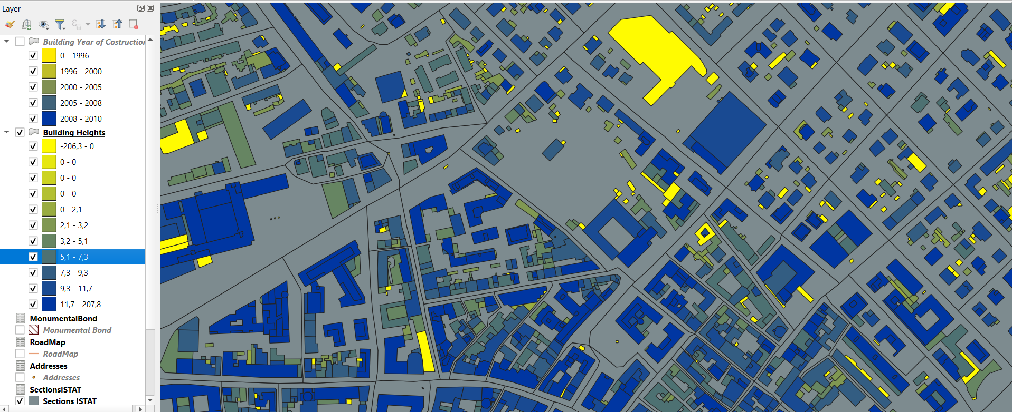
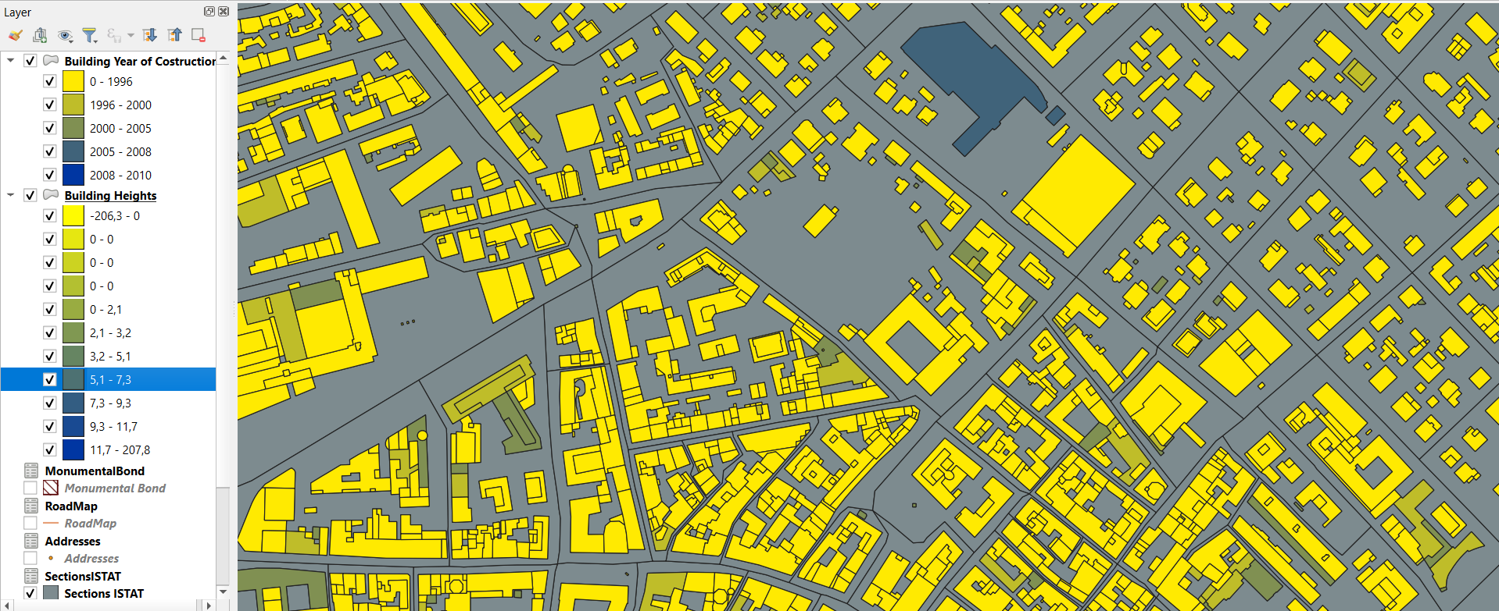
Results : generated Shapefiles WITH GIS
Building Heights Visualization: This map highlights the vertical dimension of the city's architecture by color-coding buildings according to their height. Buildings are represented in a spectrum of colors from deep blue (lowest heights) to bright yellow (highest heights), offering a quick visual assessment of the urban density and skyscape of Pesaro.
Year of Construction Mapping: This visualization provides insights into the developmental timeline of Pesaro's buildings. The color gradient ranges from dark blue for the oldest structures to bright yellow for the most recent constructions, revealing patterns of urban expansion and historical preservation areas within the city.

